Slide 1

Consumer Electronics Sales Analysis
- Dataset: Electronics Sales (2019)
- Tools: Python (Pandas, Matplotlib)
- Objective: Analyze sales trends and demand patterns
VU PHUONG UY (부푸옹우이)

Slide 2
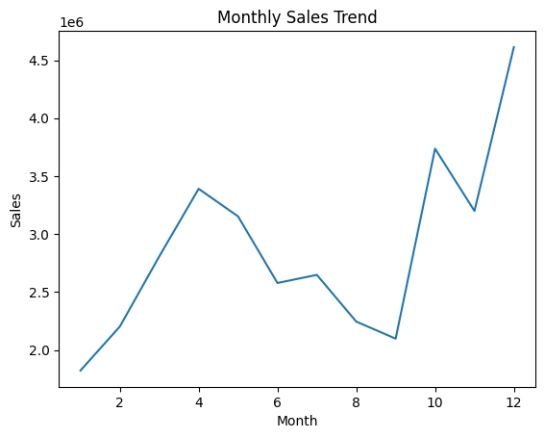
SALES TREND 📈
Sales show a clear upward trend throughout the year, with a significant peak in November and December.
This indicates strong seasonal demand driven by holiday shopping.

Slide 3
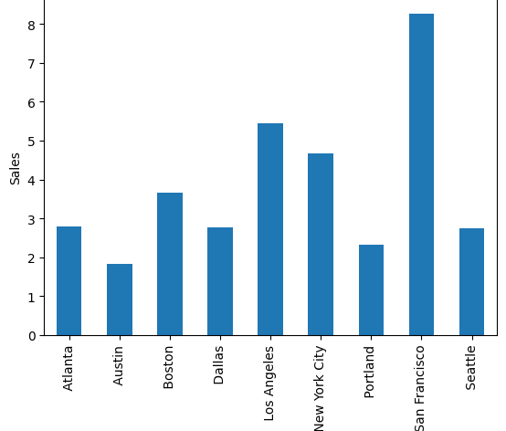
SALES BY CITY 🌍
Major cities such as San Francisco, Los Angeles, and New York generate the highest sales. San Francisco shows the highest sales among all cities.
This highlights strong demand in urban areas.

Slide 4
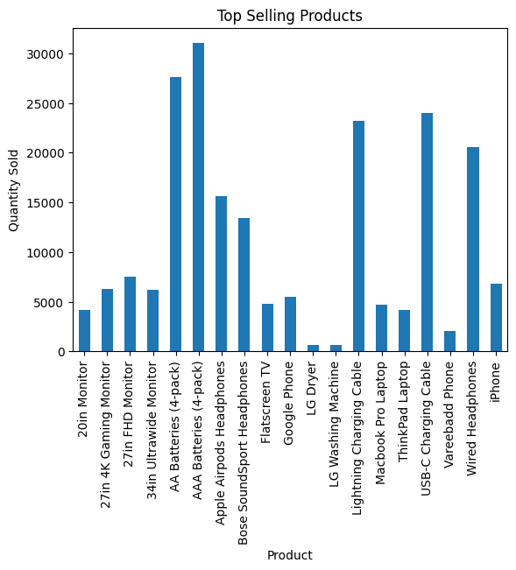
TOP PRODUCTS 📊
Smartphones and accessories are the most frequently purchased products.
These products are key drivers of consumer electronics demand.

Slide 5
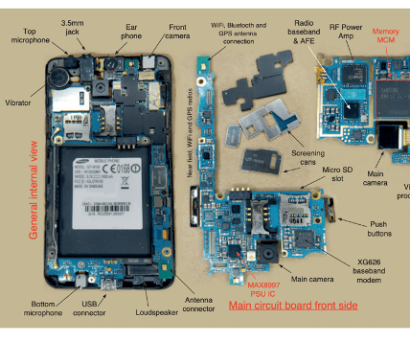
BUSINESS INSIGHT
Consumer electronics demand drives semiconductor industry growth. Electronics Demand (↑) → Semiconductor Demand (↑) → Memory Chips (DRAM, NAND)
Increased demand for smartphones, laptops, and accessories leads to higher demand for memory chips such as DRAM and NAND, which are essential for modern computing and data processing.

